Slide 1


Winnington-Barnton Bridge A533 Corridor Study
Project Update – Members Briefing
February 2021

Slide 2
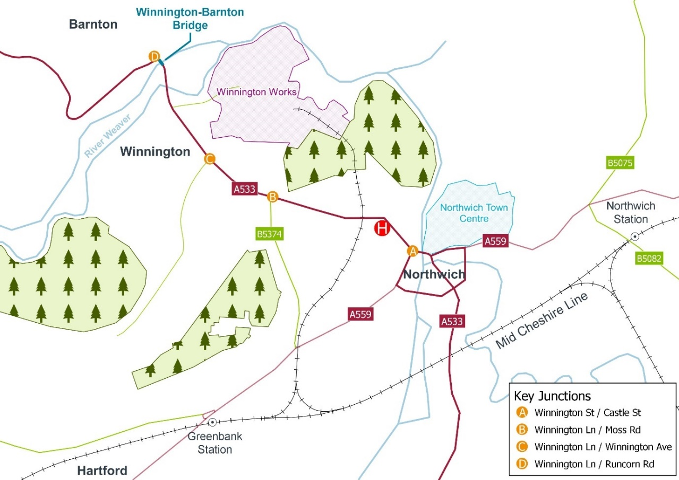
Study Background
2015
e-petition of circa 4,400 names regarding traffic congestion caused by the swing bridge.
A new bridge between Winnington and Barnton was identified in the Northwich Transport Strategy to improve connectivity.
AECOM commissioned to develop a Strategic Outline Business Case to understand the feasibility and potential benefits of improvements to the transport provision in this area.
2018
2019/20
DRAFT | CONFIDENTIAL
Notes:
Study seeks to identify options to improve transport connectivity at the Winnington-Barnton bridge over the River Weaver which is an existing pinch-point on the highway network…also the onward accessibility along the A533 Corridor to Northwich Town Centre which is approx. 1 mile from the bridge.
E-petition in 2015 highlights the importance of the corridor for locals and the social inclusion benefits that are likely as a result of the enhanced accessibility.
NTS identified a new bridge.
Highlight Winnington Works – scheme also support connectivity to proposed regeneration site.

Slide 3
Scheme Objectives
To improve journey times and journey time reliability along the A533 Corridor between Northwich and Barnton
To support increased levels of active and sustainable travel along the A533 Corridor to Northwich Town Centre
To ensure the transport network facilitates and supports existing, proposed and potential development sites along the A533 Corridor and its vicinity
To minimise the adverse impacts of the highway network on the local environment and adept network to the effects of climate change
To reduce congestion and improve resilience at the Winnington-Barton river crossing
To ensure the Winnington-Barnton river crossing can be used by vehicles of all weights
To reduce congestion at the A533 / B5374 (Moss Road) and A533 / Castle Street junctions
To reduce the number and severity of collisions along the A533 Corridor
To enhance access to the public transport network
To improve and increase the quality and quantity of active travel provision
To reduce the number and severity of collisions involving cyclists and pedestrians
To unlock development at the Tata site (Winnington Works)
To enhance connectivity for local movements and access to the Strategic Road Network
To improve accessibility for existing residents, particularly those in deprived areas to support access to jobs, education, health, leisure and opportunity
To support tourism / leisure aspirations
To ensure the scheme design considers environmental issues at an early stage of the project to minimise the impacts on the local environment
To take steps to ensure the transport network contributes positively to the Climate Emergency
To ensure delivery of the scheme engages with the local community to secure support for the scheme
DRAFT | CONFIDENTIAL
Notes:
Scheme objectives accompanied by a series of sub-objectives

Slide 4

Study Overview – Phase One
08 Production of SOBC
The SOBC will be produced to present the findings in line with the DfT Five Case Model
01 Inception
Confirm study scope
07 Economic Appraisal
Economic appraisal of the transport and wider economic impacts
02 Establish Need for Intervention and Scheme Objectives
Policy and strategy review, evidence review, define scheme objectives
Winnington Barnton Bridge A533 Corridor Study
06 Transport Modelling
Modelling of: (i) River Crossing + Junction Improvements, (ii) River Crossing + Junction Improvements with additional developments along corridor included, (iii) River Crossing
03 Option Identification
Suite of options identified for the River Crossing and A533 Corridor
05 Preliminary Design & Costing
Preliminary design for the River Crossing and Junction Improvements to inform initial cost estimates
04 Option Assessment
Assessment of the options based on scheme objectives, policy fit and aspects of deliverability
DRAFT | CONFIDENTIAL
Notes:
Highlight some tasks occur in parallel
Strategic Case based on NfI, Option Identification, Option Assessment
Modelling to inform NfI used to assess the options
Subject to SOBC findings…an OBC will be developed including option refinement, stakeholder engagement, revised appraisal, Geotech work

Slide 5
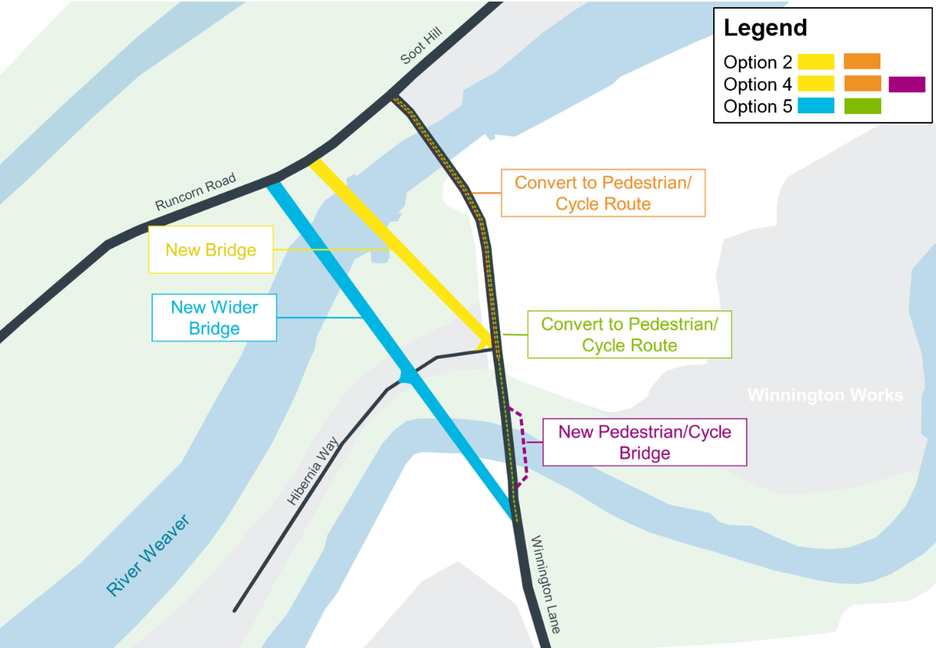
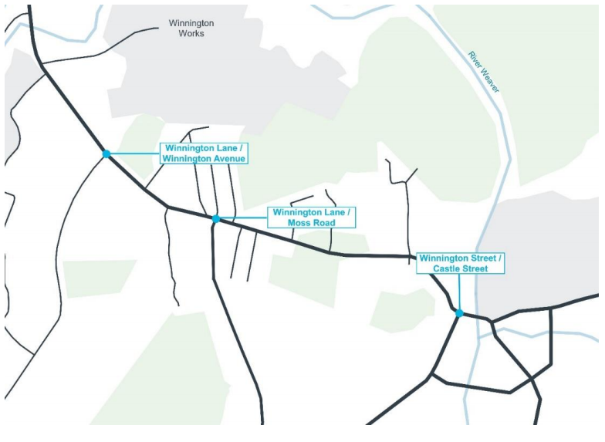
Short Listed Options
River Crossing
Junction Upgrades
Option A: Narrow
Option 2 + Junction Upgrades
Option B: Narrow plus
Option 4 + Junction Upgrades
Option C: Wider
Option 5 + Junction Upgrades
DRAFT | CONFIDENTIAL

Slide 6
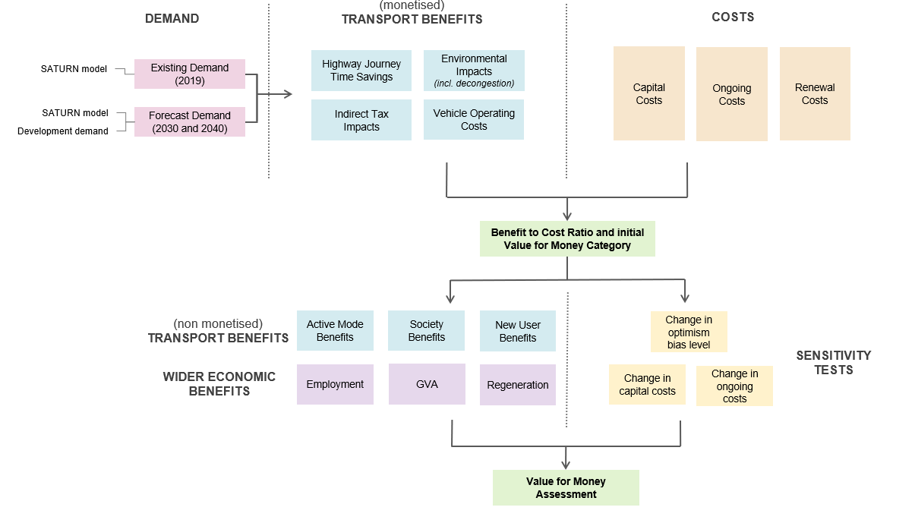
Appraisal Approach
DRAFT | CONFIDENTIAL

Slide 7
Appraisal Results
 | Option A: Narrow | Option B: Narrow Plus | Option C: Wider
July 2020 Databook
PVC | £11,889 | £12,227 | £16,026
PVB | £78,629 | £78,629 | £78,629
BCR | 6.6 | 6.4 | 4.9
July 2020 Databook - Sensitivity
PVC | £11,785 | £12,190 | £15,885
PVB | £66,278 | £66,278 | £66,278
BCR | 5.6 | 5.4 | 4.2
Key Assumptions:
Appraisal period: 60 years
Opening year: 2024 (Indicative)
Transport modelling does not distinguish crossing options
Use of July 2020 Databook
Use of TUBA
Standard treatment of capital costs
No ongoing / renewal costs included at this stage
£000s, discounted to 2010 prices
DRAFT | CONFIDENTIAL

Slide 8
Appraisal Commentary
High-level initial economic appraisal has highlighted:
  BCR for Option A and B is notably higher reflecting lower cost for same level of monetised benefit
  Option C has higher cost and lower BCR, though still in the ‘Very High’ Value for Money category
  Option C likely to have greater benefits for active mode users, which would support the Value for Money
  Scheme expected to support developments (incl. Winnington Works) with these wider benefits supporting the Value for Money
  Off-peak and weekend transport benefits not captured in the modelling to date, and are likely to improve the Value for Money
  Adverse environmental impacts anticipated which would reduce the Value for Money
DRAFT | CONFIDENTIAL

Slide 9
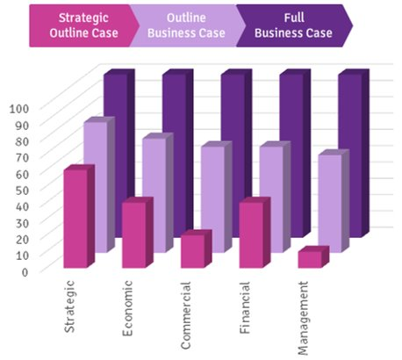
Next Steps of Study – Phase Two
Progress to Outline Business Case:
  Ground Investigation (GI) activity
  Preliminary Ecology Appraisal (PEA)*
  Desktop environmental study*
  Structure development of wider alignment*
  Refine tie-in between new crossing and highway
  Refine junction improvements
  Review active travel measures
  Engagement activity
  Seek funding sources
* TBC
DRAFT | CONFIDENTIAL

Slide 10
Engagement Activity
One-to-One Discussion
Canal & River Trust
River Weaver Navigation Society
Sustrans
Emergency Services (CWaC)
Public Health (CWaC)
Email
Historic England
Natural England
Gadbrook Park BID
Highways England
Highway Authorities
Transport Operators (via CWaC)
Briefing
Parish Councils
Local Councillors / Elected Representatives

Slide 11
Thank You
Cheshire West & Chester Council
Jamie Barron
Jamie.Barron@cheshirewestandchester.gov.uk
Jamie Matthews
Jamie.Matthews@cheshirewestandchester.gov.uk
AECOM
Tom Marsden
tom.marsden@aecom.com

